Slide 1
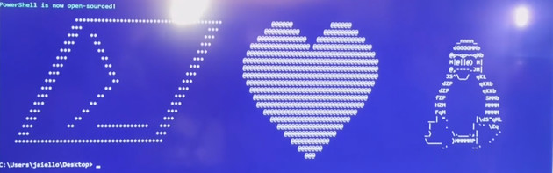
Start-NewEra.ps1 –Repo PowerShell

Slide 2
WHOAMI
Name : Ben Gelens
Job : Consultant
MVP : CDM (PowerShell)
Company : inovativ
Email : ben@bgelens.nl
Twitter : @bgelens
Community : {Hyper-V.nu, azurestack.eu, DuPSUG}
Blogging : {Hyper-V.nu, PowerShellMagazine.com, azurestack.eu}

Slide 3
Agenda
Announcement
MIT License
Repo’s
Demo, Demo, Demo

Slide 4

Announcement:
On August 18th2016 @ 11:14EST, PowerShell was made available on *NIX, OSX and Windows.
Current version: 6.0.0-alpha.9
Also, PowerShell now is OSS using MIT license!
PSRP over SSH

Slide 5

MIT License
Permission is hereby granted, free of charge, to any person
obtaining a copy of this software and associated documentation
files (the "Software"), to deal in the Software without
restriction, including without limitation the rights to use,
copy, modify, merge, publish, distribute, sublicense, and/or sell
copies of the Software, and to permit persons to whom the
Software is furnished to do so, subject to the following
conditions:
The above copyright notice and this permission notice shall be
included in all copies or substantial portions of the Software.
<……..>

Slide 6
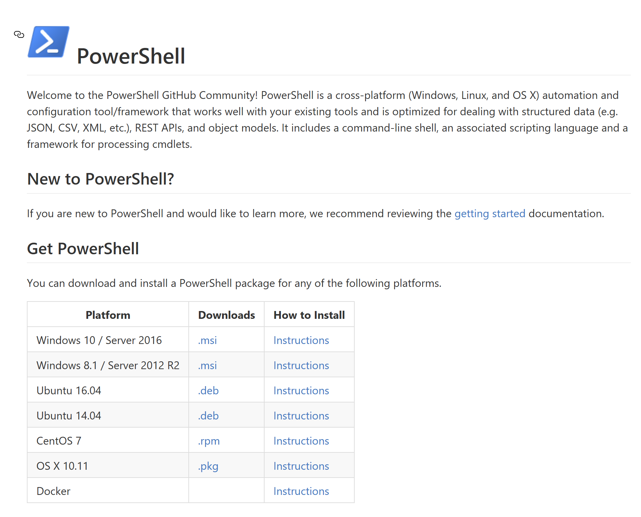

Important Repo’s
https://github.com/PowerShell/PowerShell
https://github.com/Microsoft/omi
https://github.com/Microsoft/PowerShell-DSC-for-Linux
https://github.com/PowerShell/psl-omi-provider
https://github.com/PowerShell/Win32-OpenSSH
https://github.com/PowerShell/PowerShell-RFC

Slide 7




Slide 8
Thanks! Questions?
Name : Ben Gelens
Job : Consultant
MVP : CDM (PowerShell)
Company : inovativ
Email : ben@bgelens.nl
Twitter : @bgelens
Community : {Hyper-V.nu, azurestack.eu, DuPSUG}
Blogging : {Hyper-V.nu, PowerShellMagazine.com, azurestack.eu}

